Slide 1
Welcome!
Notes:
PRESENTATION
Explain your role in the community and the type of work you do.
Present the workshop:
Part one: Importance of making a will and how to make one
Part two: First steps after a loved one dies
The objective of the workshop isn’t to explain all the rules for estates. We’re going to focus on practical information for making a will and on the first steps to take after a loved one dies.
The Indian Act has special rules for the wills and estates of First Nations people living in a community (“reserve”). We will focus on those rules today.
In particular, this workshop is for First Nations people who:
Are registered under the Indian Act, and
Normally live in a community (“reserve”). This is the case even if:
The person is temporarily away from the community
The person has to live away from the community, for example, to study, work or for health reasons
This workshop doesn’t apply to you if you live in Quebec and your are in one of these situations:
You live outside your community
You are Inuit, Cree of Métis
You aren’t indigenous
In these cases you have to follow the rules in the Civil Code of Quebec.
IMPORTANT
Explain to participants that you can’t give them legal advice. This means you can’t answer specific questions about their personal legal issues. But you can answer questions by providing general information.
Participants who have specific questions can do the following:
Contact a lawyer or notary.
Contact Indigenous Services Canada.
Contact the community’s Indian Registration Administrator, who can guide participants to the right resources and help them with the steps they need to take.
This workshop is updated to December 2021. To ensure the information is still valid, see Éducaloi’s website: educaloi.qc.ca/en.

Slide 2
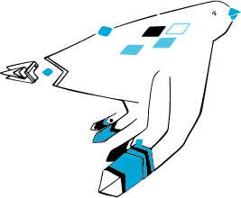
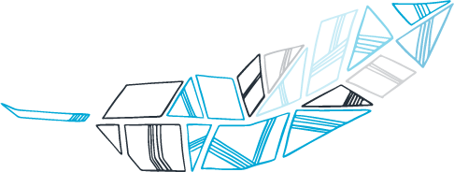
Wills and Estates for people living in a community
Notes:
ICE-BREAKER ACTIVITIES
If you have the right number of participants, we suggest doing an icebreaker, or having everyone introduce themselves. Here are some examples of questions you can ask:
What community are you from and what is your role there?
What word best represents why you’re participating in the workshop. Example: protection
Have you heard about this topic in your community?
What are your expectations for this workshop?

Slide 3
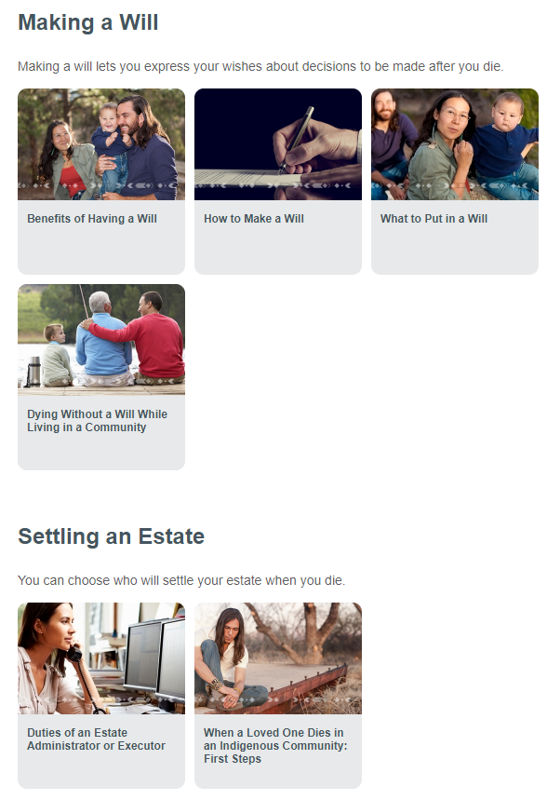
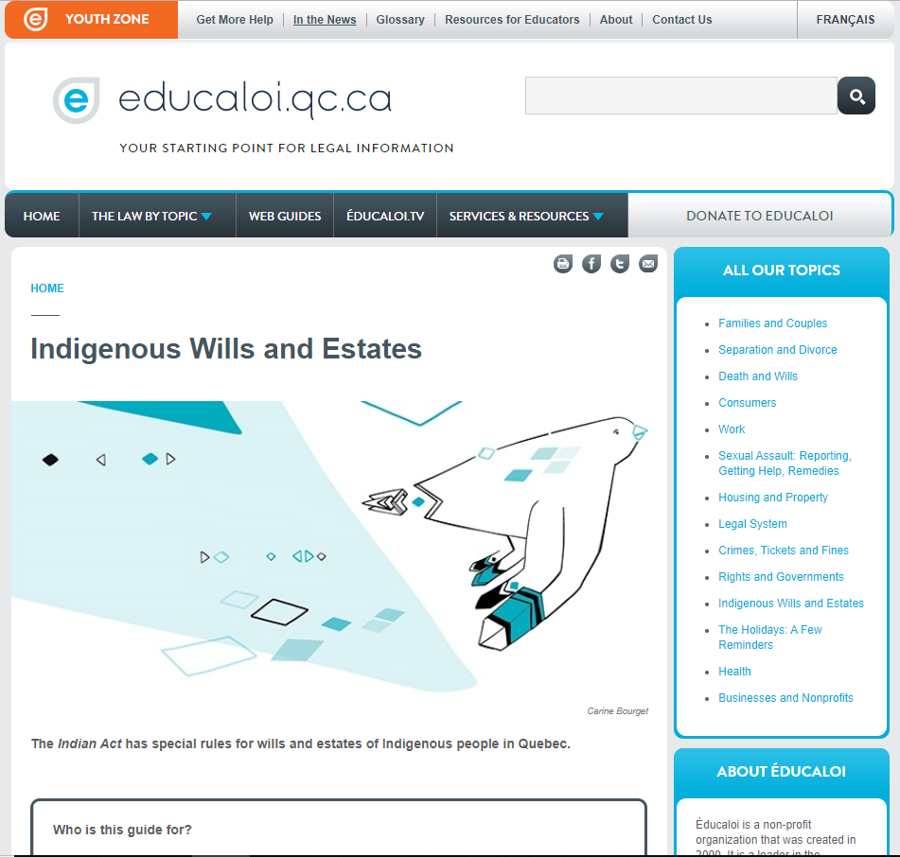
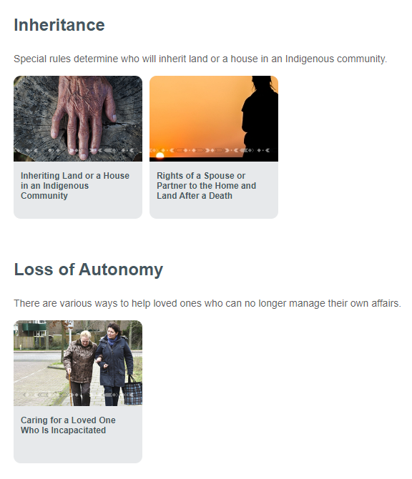
Notes:
INFORMATION FOR PARTICIPANTS
Today’s workshop provides a short summary of wills and estates for First Nations people living in a community in Quebec. It covers general concepts, not specific details.
If participants want more information about the topic, or if they forget some of the information provided during the workshop, they can visit Éducaloi’s website. Éducaloi is a non-profit organization (non-governmental) whose mission is to explain the law using plain language.
Éducaloi’s website has articles about wills and estates for members of First Nations who live in a community (educaloi.qc.ca/en/indigenous-wills-and-estates):
Benefits of Having a Will
How to Make a Will
What to Put in a Will
Dying Without a Will While Living in a Community
Duties of an Estate Administrator or Executor
When a Loved One Dies in an Indigenous Community
Inheriting Land or a House in an Indigenous Community
Rights of a Spouse or Partner to the Home and Land After a Death
Caring for a Loved One Who Is Incapacitated
IMPORTANT
Participants can order pamphlets on this topic through Éducaloi’s website.
educaloi.qc.ca/en/order-educalois-products/

Slide 4
Making a Will
Part 1:
Notes:
You can begin the workshop by opening up a discussion with participants. This will give you a better idea of their situation and needs. You can let participants know ahead of time how many answers you will take depending on the time you’ve allotted for discussion.
DISCUSSION POINTS
In your opinion, what is a will for?
Is it important to have a will? Why or why not?
Have you thought about what you want to happen after you die?
Who will take care of your children?
Who will get your property?
What type of funeral do you want?
Do your loved ones know about your wishes in case something happens to you?
How have you told them? Verbally or in writing?
Are you sure your wishes will be respected?
Do you know who will take care of your affairs after you die?

Slide 5
Why should you make a will?
To make your own decisions
To make things easier for your loved ones
Notes:
INFORMATION FOR PARTICIPANTS
If you die without a will:
your property will be distributed according to what the Indian Act says—not according to your wishes. Neither you nor your family members will be able to decide what happens to your property.
To have more control over what happens after you die, you can write a will. That way:
You can choose a person to settle your affairs (called an “executor”).
You decide who will get your property.
You can make other decisions, for example,
who will take care of your children, and
what type of funeral you want.
Having a will also makes things easier for your loved ones. They will know exactly what your wishes are.
TO LEARN MORE
educaloi.qc.ca/en/indigenous-wills-and-estates
Benefits of Having a Will
Dying Without a Will While Living in a Community
Sources:
Indian Act, RSC 1985, c I-5, ss 45, 48.

Slide 6
If you die without a will . . .
. . . your property will be distributed based on what the Indian Act says, not according to your wishes.
Notes:
POINTS TO DISCUSS BEFORE PROVIDING INFORMATION TO PARTICIPANTS (Say you can take 2-3 comments)
What happens when someone dies without a will in your community?
Can the community get information about what to do in these cases? If yes, where does the information come from?
Do you have loved ones who have died without a will?
What happened?
How were decisions made?
INFORMATION FOR PARTICIPANTS
If you don’t have a will, your loved ones won’t be able to decide who gets your property after you die. It will be distributed based on what the Indian Act says.
The Indian Act has specific rules depending on whether or not you have a partner.
A partner can be
the person you are married to (your spouse), or
the person you have lived with as a couple for over a year (common-law partner).
For more information on how property is distributed when there is no will, participants can refer to these articles on Éducaloi’s website (educaloi.qc.ca/en/indigenous-wills-and-estates):
Benefits of Having a Will
Dying Without a Will While Living in a Community
OPTIONAL INFORMATION (rules that apply if there is no will)
If the person who died had a partner at the time of death and:
The estate is worth $75,000 or less:
Everything goes to the partner.
The estate is worth more than $75,000:
No children: Everything goes to the partner.
One child: $75,000 goes to the partner and the rest of the estate is divided equally between the partner and the child.
Two or more children: $75,000 goes to the partner and the rest is divided as follows: 1/3 to the partner and 2/3 is distributed evenly among all the children.
**Note: The partner of the person who died has special rights to the family home and may have rights to land in the community (“reserve”). This topic will be covered later in the workshop.
If the person who died didn’t have a partner at the time of death and:
There are children:
Everything is divided equally among them. If one of the children dies first, their share goes to their own children (the grandchildren of the person who died).
There are no children:
Everything goes to the parents.
There are no children or living parents:
Everything goes to the brothers and sisters. If a brother or sister has already died, their share goes to their children (the nieces and nephews of the person who died).
There are no children, brothers, sisters or living parents
Any land in the community goes to the Band and not the family members. Everything else is divided among the closest relatives (cousins, aunts, etc.).
In all cases:
Children will receive the same amount whether they are biological children or adopted.
If children die before a parent passes away, the children’s share will go to their own children (that is, to the grandchildren of the person who died).
Sources:
Indian Act, RSC 1985, c I-5, ss 2(1), 48.

Slide 7
How can you make a will?
A will must be:
Written
Specific
Signed
Notes:
POINTS TO DISCUSS BEFORE PROVIDING INFORMATION
Are there rules you have to follow when you make a will?
What are they?
What happens if you don’t follow the rules?
Tip: Participants can divide into teams of two to answer the questions. Then some of the teams can share their answers.
INFORMATION FOR PARTICIPANTS
You can make a will yourself for free without a lawyer or notary.
But a lawyer or notary can help you make your will if your situation is complicated.
For example, if you own a house or business.
You must be accompanied by an official interpreter if you don’t speak the notary’s language (e.g., English or French).
If you make your own will, there are rules to follow. It must be:
Written (by hand or using a computer)
You can write it in your own language, but your loved ones will have to pay to get it translated after you die if it’s written in a language other than English or French.
Another person can write it for you. Make sure that person writes down exactly what you say. For example:
Ask two trusted people to make sure what was written down is what you want.
Communities can develop their own procedures to make sure that wills written with help from others respect the person’s wishes.
Specific
Your will must clearly state who you want your property to go to.
This will make things easier for your loved ones.
Signed by you
It’s a good idea to sign your will in front of two people you trust (witnesses) and have them sign it as well. If another person helped you write your will, you can ask these two witnesses to make sure what was written respects your wishes.
Write the date next to each signature (including yours).
Your will might not be valid if it doesn’t meet these conditions.
If your will isn’t valid, your property will be distributed as if you didn’t have a will.
Other important information
Keep your will in a safe place.
Tell a person you trust, or the person who will take care of your affairs after you die, where you keep your will.
Reminder: These rules only apply to First Nations people who live in a community. If you are First Nations but live outside of your community, the rules may be different. The Civil Code of Québec might apply to you instead of the Indian Act.
TO LEARN MORE
educaloi.qc.ca/en/indigenous-wills-and-estates
How to Make a Will
Sources:
Indian Act, RSC 1985, c I-5, ss. 45, 46.

Slide 8
What should you put in your will?
Who will inherit your property?
Who will take care of your children?
Who will settle your estate?
What kind of funeral do you want?
Notes:
INFORMATION FOR PARTICIPANTS
These are some of the things you can include in your will:
Who will inherit your property
You can choose your heirs by saying who exactly will get your car, money, jewellery, furniture, etc.
If you have land or a house in the community, special rules apply. You can’t leave this land to anyone you want. Also, your spouse or common-law partner might have rights to the land no matter what your will says.
We’ll talk about the rules on land in the community later in the presentation.
Who will take care of your children
You can name a tutor (guardian) for your children under 18. A tutor is a person who protects your minor children, manages their property, helps them and acts on their behalf to protect their interests.
This person will take care of your children if their other parent dies before you or at the same time.
Who will manage your affairs after you die (This is sometimes called settling your estate.)
After you die, someone will have to pay your debts, close your accounts, notify your heirs, etc.
This person is called an “executor” if you name them in your will.
You can make your executor’s job easier by doing these things:
Write down the location of the property you want to leave to your heirs.
Make a list of your debts.
Write down the full names and addresses of the people you want to leave your property to (your heirs).
You can name several executors to settle your estate together.
You can also make a list of executors and say who you prefer (for example, “I name my husband as my executor. If he dies or is unavailable, I name my son.”)
Note: Check to make sure participants understand the concepts ”heir”, “tutor”, and “executor”.
What kind of funeral do you want?
You can say whether you want to be buried or cremated.
You can also plan your funeral in advance with a funeral home.
Your will is usually opened only after your funeral. It’s best to speak with your loved ones ahead of time so they’ll know what your wishes are.
RESOURCES
You can ask a notary or lawyer if you want help or if your situation is complicated.
For example, if you own a house or business.
To find a notary: trouverunnotaire.cnq.org (then select English).
To find a lawyer: www.barreau.qc.ca/en/find-lawyer/referral-services/
If you contact a professional, it’s important to mention that you are a First Nations person living in a community (“reserve”) because different rules apply.
TO LEARN MORE
educaloi.qc.ca/en/indigenous-wills-and-estates
What to Put in a Will
Sources:
Indian Act, RSC 1985, c I-5, s 45.
Civil Code of Quebec, arts 42, 200.
Indian Estates Regulations, CRC, c 954, s 9.

Slide 9
What if you change your mind?
Option 1: Make a new will and throw out the old one.
Option 2: Write the changes directly on your will.
Notes:
INFORMATION FOR PARTICIPANTS
If your situation or wishes change, you can change your will in two ways:
Option 1: Make a new will and throw out the old one.
The rules are the same: written, specific, signed (slide 6).
Option 2: Write the changes directly on your will.
In this case, you must put your initials and the date beside each change.
You can also add a page and sign it.
It is strongly recommended that you make these changes in front of two people you trust (witnesses) and have them sign the changes.
TO LEARN MORE
educaloi.qc.ca/en/indigenous-wills-and-estates
How to Make a Will

Slide 10
When a Loved One Dies: First Steps
Part 2:
Notes:
DISCUSSION POINTS
To your knowledge, what are the first steps you have to take when a loved one dies?
Have you ever lost people close to you?
Did they have a will?
Were their affairs in order?
Were there any specific steps to follow?
How were decisions made?
Were their wishes carried out?
NOTES
This section includes a lot of information. Participants don’t have to retain everything. They will receive pamphlets at the end of the workshop with the most important information. They can also visit Éducaloi’s website for more information.

Slide 11
First Steps
1. Notify:
Indigenous Services Canada
Directeur de l’état civil du Québec
2. Look for a will
3. Plan the funeral
4. Find out who will settle the estate
Notes:
INFORMATION FOR PARTICIPANTS
Important: Your community’s Indian Registration Administrator can advise and guide you on the steps to take.
Here are the first four steps:
Notify these two government bodies:
Indigenous Services Canada (ISC)
You can ask your community’s Indian Registration Administrator to call ISC for you.
Or you can call ISC directly at 1-800-263-5592.
ISC will send you forms to complete and return with other documents.
Directeur de l’état civil du Québec (Quebec government agency that manages documents like birth certificates, marriage certificates and death certificates)
The funeral home can help you send the necessary documents to the Directeur de l’état civil.
The Directeur de l’état civil will then send you an act of death. This is an official document that proves a person died. You’ll need it to settle the estate.
Additional information:
- If you don’t tell ISC about the death, the Directeur de l’état civil du Québec will tell them. In this case, ISC will contact you by mail.
(2) Look for a will.
Check for a will in the registers of the Chambre des notaires du Québec (professional association of notaries) and the Barreau du Québec (professional association of lawyers).
The fee is around $20 for each registry.
Next, look for a will in the person’s papers.
You must tell Indigenous Services Canada (ISC) whether or not you find a will. If you find one, you must send it to ISC for approval.
(3) The funeral service must respect the final wishes of the person who died.
To find out the person’s wishes about the funeral, you can
check the will (if there is one),
talk to the family members and close friends of the person who died, and
look through the person’s papers for a contract for funeral services arranged in advance.
If the person didn’t mention anything about the service, the heirs decide what to do. (Heirs are people who inherit things from the person who died.)
The Quebec Pension Plan might pay some funeral costs if the person who died contributed a minimum amount to the plan. If not, the Ministère du Travail, de l’Emploi et de la Solidarité sociale (department of employment and social solidarity) might give you a special refund.
For more information, call 1-877-644-4545.
(4) Find out who will settle the estate.
This is the person who will deal with the affairs of the person who died. The next slide is on this topic.
RESOURCES
Chambre des notaires du Québec (professional association of notaries): www.cnq.org/en/will.html
Barreau du Québec (professional association of lawyers): www.barreau.qc.ca/en/wills-mandates/
Indigenous Services Canada: 1-800-263-5592 or www.canada.ca/en/indigenous-services-canada.html
TO LEARN MORE
educaloi.qc.ca/en/indigenous-wills-and-estates
When a Loved One Dies in an Indigenous Community: First Steps

Slide 12
Who will settle the estate?
Notes:
INFORMATION FOR PARTICIPANTS
How do we decide who will settle the estate?
Once Indigenous Services Canada (ISC) has all the necessary documents, it will name someone to settle the estate.
This person is called an executor if the deceased chose them and it is written in the will.
If the will does not say who will settle the estate, ISC will ask the family or heirs for a recommendation. If this is the case, the person who settles the estate is called an administrator.
People can refuse to be an executor or administrator.
ISC will appoint a replacement in this case.
The duties of the executor or administrator include:
Contacting all services and organizations the deceased dealt with and closing their accounts (example: phone, electricity, Quebec Pension Plan).
Opening an estate bank account
Identifying and notifying the heirs (heirs named in the will or heirs under the Indian Act)
Making an inventory of the property and debts of the person who died
Paying taxes and the deceased’s debts using money in the estate (before distributing property to heirs)
Distributing property to heirs
* Here it’s important to keep in mind the rights of spouses and common-law partners
Close the estate
RESOURCES
Indigenous Services Canada: 1-800-263-5592 or www.canada.ca/en/indigenous-services-canada.html
TO LEARN MORE
educaloi.qc.ca/en/indigenous-wills-and-estates
Duties of an Estate Administrator or Executor
When a Loved One Dies in an Indigenous Community: First Steps
Sources:
Indian Act, RSC 1985, c I-5, s 43.
Indian Estates Regulations, CRC, c 954, ss 4, 11.

Slide 13
Special Rules
Land
Spouse or Common-Law Partner
Notes:
INFORMATION FOR PARTICIPANTS
Land
There are special rules when someone inherits land or a house in a First Nation community:
Only First Nation members can use and occupy land in a community covered under the Indian Act. You can’t directly inherit land in the community without being a member of the Band that occupies the land.
This is the case even if the person who died left land to a non-member in their will.
Sometimes, a non-member named in a will can receive a share of the value of the land after it is sold. For example, this can happen when the person who died had a Certificate of Possession for the land.
If the person who died had a Certificate of Possession for the land, the person who settles the estate must ask Indigenous Services Canada to transfer the land rights to the heir. The community’s Land Agent or Indian Registration Administrator can help.
If the person who died occupied the land based on a traditional system, the Band Council will be able to tell you who will inherit the home or the land.
2) Spouses or common-law partners
Spouses or common-law partners of the person who died have special rights to the family home.
Even if they aren’t a band member or a First Nations person, they are allowed to stay in the house for six months after the person’s death.
A spouse or common-law partner who isn’t a band member can’t inherit a house directly but can get a share of the value of the house.
The partner also has other specific rights to the estate. Visit Éducaloi’s website to learn more (the rules are complicated).
Reminder
A partner can be:
the person who was married to the person who died (spouse), or
the person who was living with the person who died for at least one year at the time of death (common-law partner).
TO LEARN MORE
educaloi.qc.ca/en/indigenous-wills-and-estates
Inheriting Land or a House in an Indigenous Community
Rights of a Spouse or Partner to the Home and Land After a Death
Sources :
Indian Act, RSC 1985, c I-5, ss 28, 50.
Family Homes on Reserves and Matrimonial Interests or Rights Act, SC 2013, c 20, ss 7, 12, 14.

Slide 14
Resources
Indian Registration Administrator in your community
Indigenous Services Canada: 1-800-263-5592
Éducaloi
A lawyer or notary
Notes:
NOTES
This section of the workshop is extremely important. Make sure participants know who they can contact to get help. We also recommend that you show them how to find useful websites if possible.
INFORMATION FOR PARTICIPANTS
The Indian Registration Administrator in your community can help.
Your band council can tell you who to speak to.
Indigenous Services Canada
www.canada.ca/en/indigenous-services-canada.html
1-800-263-5592
Éducaloi
educaloi.qc.ca/en/indigenous-wills-and-estates
Benefits of Having a Will
How to Make a Will
What to Put in a Will
Dying Without a Will While Living in a Community
Duties of an Estate Executor or Administrator
When a Loved One Dies in an Indigenous Community: First Steps
Inheriting Land or a House in an Indigenous Community
Rights of a Spouse or Partner to the Home and Land After a Death
Caring for a Loved One Who Is Incapacitated
Lawyer/notary
To find a notary:
trouverunnotaire.cnq.org (then select English)
To find a lawyer:
www.barreau.qc.ca/en/find-lawyer/
If you contact a lawyer or notary, it’s important to mention that you are a First Nations person living in a community (“reserve”) because different rules apply.

Slide 15
Questions / Discussion
Notes:
NOTES
Ask participants to name two things they learned from the workshop.
Take time to answer their questions and talk with them.
Give them the Éducaloi pamphlets:
“Making a Will When You Live in an Indigenous Community”
“When a Loved One Dies in an Indigenous Community”
You can contact Éducaloi to order these pamphlets free of charge. Visit Éducaloi’s website educaloi.qc.ca/en and click on Order Éducaloi’s Products at the bottom of the page. You can also type educaloi.qc.ca/en/order-educalois-products directly into your browser’s address bar.

Slide 16
Important Notice
The legal information in this guide was updated in November 2021.
This information is not legal advice in any way. If you need legal advice on a specific situation talk to a lawyer or notary.
This document can be used and reproduced for non-commercial reasons only. It cannot be modified. Any use or reproduction must mention Éducaloi.

Slide 17
Thanks for participating!
This workshop was updated thanks to financial support from the First Nations of Quebec and Labrador Health and Social Services Commission (FNQLHSSC)
Notes:
NOTES
Thank you for your participation. We hope you enjoyed the workshop!

